Slide 1
Fundamentals of the Analysis of Algorithm Efficiency
0750323 Algorithms
Dr. Raneem Qaddoura

Slide 2
The Analysis Framework

Slide 3
Analysis of algorithms
Dimensions:
  Generality
  Simplicity
  Time efficiency
  Space efficiency
The term “analysis of algorithms” is usually used in a narrower, technical sense to mean an investigation of an algorithm’s efficiency with respect to two resources: running time and memory space
Approaches:
  Theoretical analysis
  Empirical analysis

Slide 4
Analysis of algorithms
Time efficiency, also called time complexity, indicates how fast an algorithm runs.
Space efficiency, also called space complexity, refers to the amount of memory units required by the algorithm in addition to the space needed for its input and output.

Slide 5
Theoretical analysis of time efficiency
Time efficiency is analyzed by determining the number of repetitions of the basic operation as a function of input size
Basic operation: the operation that contributes the most towards the running time of the algorithm
T(n) ≈ c_{op}C(n)
Note: Different basic operations may cost differently!
input size
running time
execution time
for basic operation
or cost
Number of times basic operation is executed

Slide 6
Measuring the Input’s size
Almost all algorithms run longer on larger inputs.
For example, it takes longer to sort larger arrays, multiply larger matrices, and so on.
Therefore, it is logical to investigate an algorithm’s efficiency as a function of some parameter n indicating the algorithm’s input size

Slide 7
Input size and basic operation examples
Problem | Input size measure | Basic operation
Searching for key in a list of n items | Number of list’s items, i.e. n | Key comparison
Multiplication of two matrices | Matrix dimensions or total number of elements | Multiplication of two numbers
Checking primality of a given integer n | n’size = number of digits (in binary representation) | Division
Typical graph problem | #vertices and/or edges | Visiting a vertex or traversing an edge

Slide 8
Types of formulas for basic operation’s count
Exact formula
e.g., C(n) = n(n-1)/2
Formula indicating order of growth with specific multiplicative constant
e.g., C(n) ≈ 0.5 n²
Formula indicating order of growth with unknown multiplicative constant
e.g., C(n) ≈ cn²

Slide 9
Order of growth
Most important: Order of growth within a constant multiple as n→∞
Example:
  How much faster will algorithm run on computer that is twice as fast?
  How much longer does it take to solve problem of double input size?

Slide 10
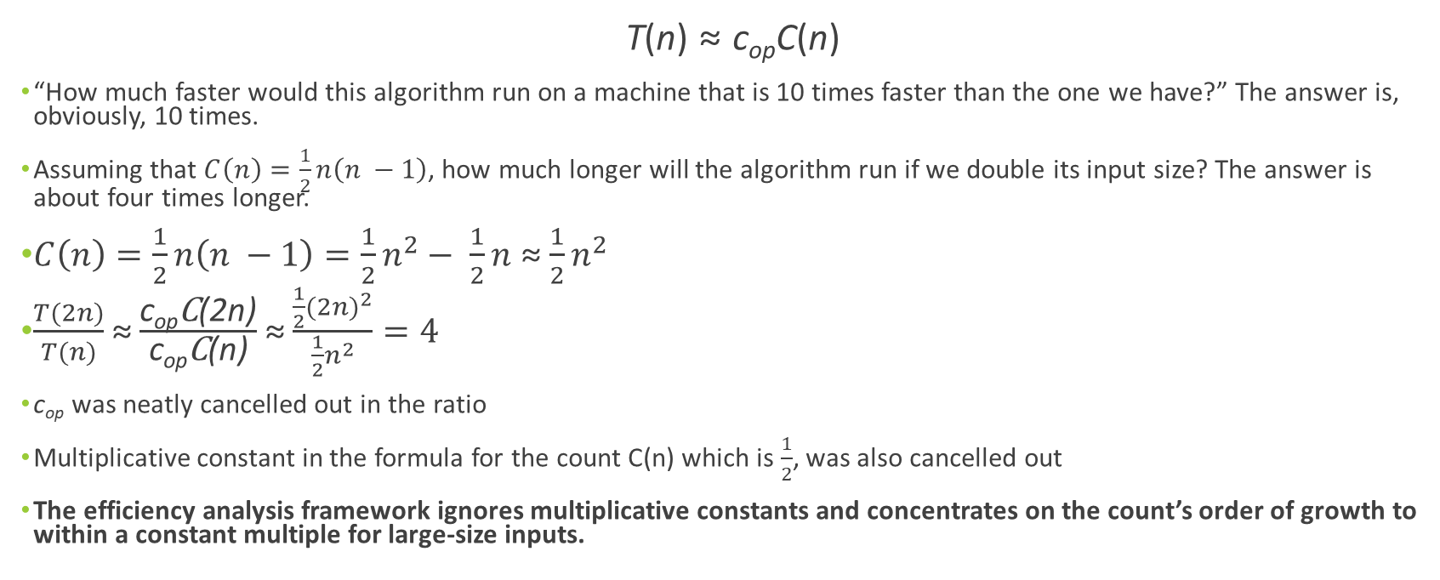
Units for measuring running time
T(n) ≈ c_{op}C(n)
“How much faster would this algorithm run on a machine that is 10 times faster than the one we have?” The answer is, obviously, 10 times.
Assuming that $C\left(n\right)=\frac{1}{2}n\left(n −1\right)$, how much longer will the algorithm run if we double its input size? The answer is about four times longer.
$C\left(n\right)=\frac{1}{2}n\left(n −1\right)=\frac{1}{2}n^{2}− \frac{1}{2}n \text{≈}\frac{1}{2}n^{2}$
$\frac{T(2n)}{T(n)}\text{≈}\frac{\text{c}\text{op}\text{C}\text{(2}\text{n}\text{)}}{\text{c}\text{op}\text{C}\text{(}\text{n}\text{)}}\text{≈}\frac{\frac{1}{2}{(2n)}^{2}}{\frac{1}{2}n^{2}}=4$
$\text{c}\text{op}$ was neatly cancelled out in the ratio
Multiplicative constant in the formula for the count C(n) which is $\frac{1}{2}$, was also cancelled out
The efficiency analysis framework ignores multiplicative constants and concentrates on the count’s order of growth to within a constant multiple for large-size inputs.

Slide 11
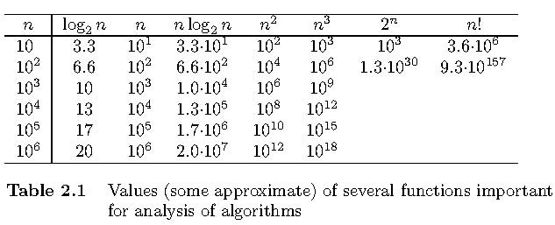
Values of some important functions as n → ∞

Slide 12
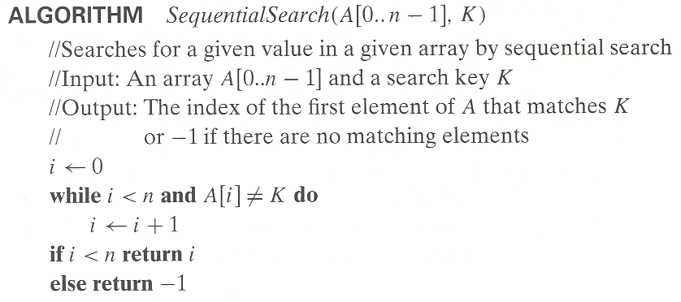
Example: Sequential search
Worst case: n key comparisons
when there are no matching elements or the first matching element happens to be the last one on the list
Best case: 1 comparisons
When the list of size n with its first element equals to a search key
Average case:
  K is in A => (n+1)/2 key comparisons
  K is not in A => n key comparisons

Slide 13
Best-case, average-case, worst-case
For some algorithms, efficiency depends on form of input:
Worst case: C_{worst}(n) – maximum over inputs of size n
The worst-case efficiency of an algorithm is its efficiency for the worst-case input of size n, which is an input (or inputs) of size n for which the algorithm runs the longest among all possible inputs of that size.
Best case: C_{best}(n) – minimum over inputs of size n
The best-case efficiency of an algorithm is its efficiency for the best-case input of size n, which is an input (or inputs) of size n for which the algorithm runs the fastest among all possible inputs of that size.
Average case: C_{avg}(n) – “average” over inputs of size n
  Number of times the basic operation will be executed on typical input
  NOT the average of worst and best case

Slide 14
Asymptotic Notations and Basic Efficiency Classes

Slide 15













Asymptotic order of growth
A way of comparing functions that ignores constant factors and small input sizes (because?)
O(g(n)): class of functions f(n) that grow no faster than g(n).
The set of all functions with a lower or same order of growth as g(n)
Ω(g(n)): class of functions f(n) that grow at least as fast as g(n)
The set of all functions with a higher or same order of growth as g(n)
Θ(g(n)): class of functions f(n) that grow at same rate as g(n)
The set of all functions that have the same order of growth as g(n)

Slide 16
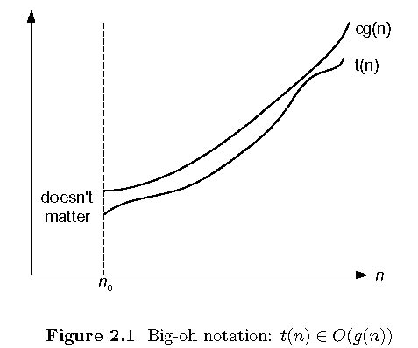
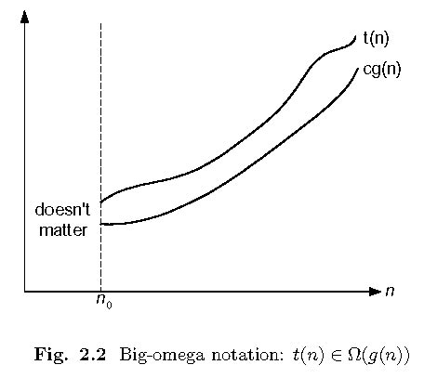
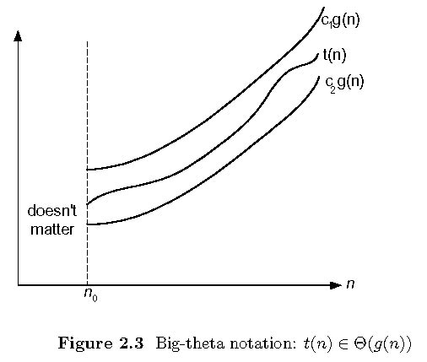
Big-oh vs Big-omega vs Big-theta
  Big-oh Big-omega Big-theta

Slide 17
Formal definition
  O-notation: A function t(n) is said to be in O(g(n)), denoted t(n) ∈ O(g(n)), if t(n) is bounded above by some constant multiple of g(n) for all large n, i.e., if there exist some positive constant c and some nonnegative integer n₀ such that
  t(n) ≤ cg(n) for all n ≥ n₀
  Ω-notation: A function t(n) is said to be in Ω(g(n)), denoted t(n) ∈ Ω(g(n)), if t(n) is bounded below by some constant multiple of g(n) for all large n, i.e., if there exist some positive constant c and some nonnegative integer n₀ such that
  t(n) ≥ cg(n) for all n ≥ n₀
  Θ-notation: A function t(n) is said to be in Θ(g(n)), denoted t(n) ∈ Θ(g(n)), if t(n) is bounded both above and below by some positive constant multiples of g(n) for all large n, i.e., if there exist some positive constant c₁ and c₂ and some nonnegative integer n₀ such that
  c₂ g(n) ≤ t(n) ≤ c₁ g(n) for all n ≥ n₀

Slide 18
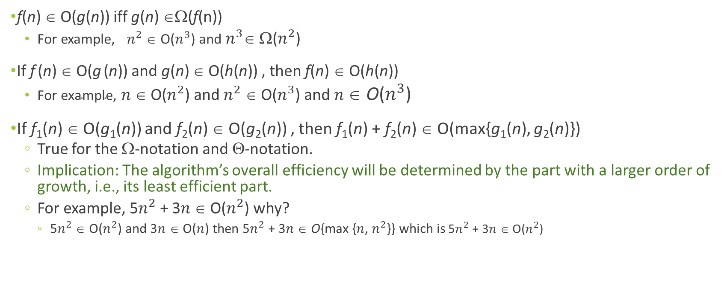
Some properties of asymptotic order of growth
f(n) ∈ O(g(n)) iff g(n) ∈Ω(f(n))
  For example, $n^{2}$ ∈ O($n^{3}$) and $n^{3}$∈ Ω($n^{2}$)
If f (n) ∈ O(g (n)) and g(n) ∈ O(h(n)) , then f(n) ∈ O(h(n))
  $\text{For} \text{example}\text{,}$ $n$ ∈ O($n^{2}$) and $n^{2}$ ∈ O($n^{3}$) and $n$ ∈ O($n^{3}$)
If f₁(n) ∈ O(g₁(n)) and f₂(n) ∈ O(g₂(n)) , then f₁(n) + f₂(n) ∈ O(max{g₁(n), g₂(n)})
  True for the Ω-notation and Θ-notation.
  Implication: The algorithm’s overall efficiency will be determined by the part with a larger order of growth, i.e., its least efficient part.
  For example, 5$n^{2}$ + 3$n$ ∈ O($n^{2}$) why?
    5$n^{2}$ ∈ O($n^{2}$) and 3$n$ ∈ O($n$) then 5$n^{2}$ + 3$n$ ∈ O{max {$n$, $n^{2}$}} which is 5$n^{2}$ + 3$n$ ∈ O($n^{2}$)

Slide 19
Mathematical Analysis of Non-recursive Algorithms

Slide 20
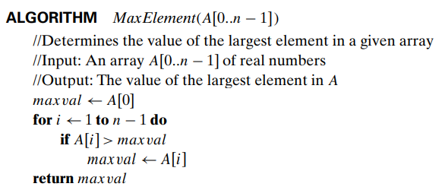
EXAMPLE 1: Max value of an array
Input’s size is the number of elements in the array, i.e., n.
The operations that are going to be executed most often are in the algorithm’s for loop
There are two operations in the loop’s body: the comparison (A[i] > maxval) and the assignment (maxval ← A[i]).
Since the comparison is executed on each repetition of the loop and the assignment is not, we should consider the comparison to be the algorithm’s basic operation.

Slide 21

EXAMPLE 1: Max value of an array
The number of comparisons will be the same for all arrays of size n; therefore, in terms of this metric, there is no need to distinguish among the worst, average, and best cases here.
C(n) the number of times this comparison is executed and try to find a formula expressing it as a function of size n.
The algorithm makes one comparison on each execution of the loop, which is repeated for each value of the loop’s variable i within the bounds 1 and n − 1,

Slide 22
General Plan for Analyzing the Time Efficiency of Nonrecursive Algorithms
Decide on a parameter (or parameters) indicating an input’s size.
Identify the algorithm’s basic operation. (As a rule, it is located in the innermost loop.)
Check whether the number of times the basic operation is executed depends only on the size of an input. If it also depends on some additional property, the worst-case, average-case, and, if necessary, best-case efficiencies have to be investigated separately.
Set up a sum expressing the number of times the algorithm’s basic operation is executed.
Using standard formulas and rules of sum manipulation, either find a closed form formula for the count or, at the very least, establish its order of growth.

Slide 23






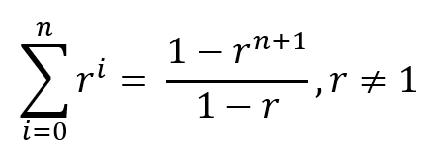
Summation formulas and rules useful in analysis of algorithms

Slide 24
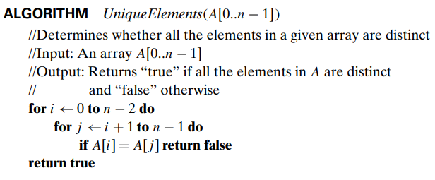
Example 2: Element uniqueness problem
The natural measure of the input’s size is n, the number of elements in the array.
Since the innermost loop contains a single operation (the comparison of two elements), we should consider it as the algorithm’s basic operation.
The number of element comparisons depends not only on n but also on whether there are equal elements in the array and, if there are, which array positions they occupy.
We will limit our investigation to the worst case only.

Slide 25
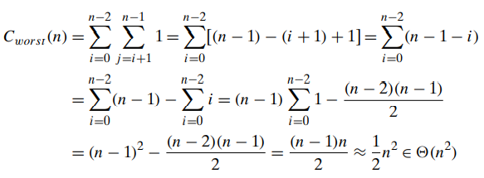
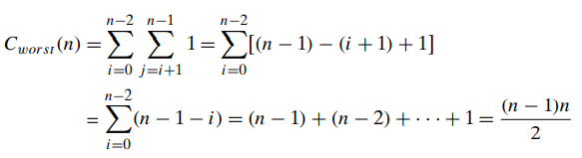

Example 2: Element uniqueness problem
By definition, the worst case input is an array for which the number of element comparisons $C_{worst}$(n) is the largest among all arrays of size n.
An inspection of the innermost loop reveals that there are two kinds of worst-case inputs: Inputs for which the algorithm does not exit the loop prematurely:
Arrays with no equal elements
Arrays in which the last two elements are the only pair of equal elements
For such inputs, one comparison is made for each repetition of the innermost loop
i.e., for each value of the loop variable j between its limits i + 1 and n − 1; this is repeated for each value of the outer loop, i.e., for each value of the loop variable i between its limits 0 and n − 2.

Slide 26
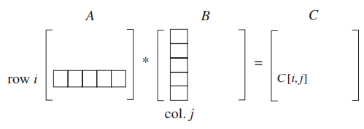
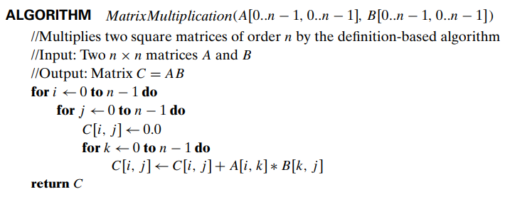
Example 3: Matrix Multiplication
We measure an input’s size by matrix order n.
There are two arithmetical operations in the innermost loop here—multiplication and addition—that, in principle, can compete for designation as the algorithm’s basic operation.
Actually, we do not have to choose between them, because on each repetition of the innermost loop each of the two is executed exactly once.
By counting one we automatically count the other.
Following a well-established tradition, we consider multiplication as the basic operation.
Set up a sum for the total number of multiplications M(n) executed by the algorithm.
Since this count depends only on the size of the input matrices, we do not have to investigate the worst-case, average-case, and best-case efficiencies separately.

Slide 27


Example 3: Matrix Multiplication
There is just one multiplication executed on each repetition of the algorithm’s innermost loop, which is governed by the variable k ranging from the lower bound 0 to the upper bound n − 1.
The number of multiplications made for every pair of specific values of variables i and j is: $\sum_{k=0}^{n−1}{1}$
Total number of multiplications M(n) is expressed by the following triple sum:

Slide 28


Example 3: Matrix Multiplication
Running time of the algorithm on a particular machine
where $c_{m}$is the time of one multiplication on the machine in question.
A more accurate estimate if we took into account the time spent on the additions
where $c_{a}$ is the time of one addition.

Slide 29
Mathematical Analysis of Recursive Algorithms

Slide 30
General Plan for Analyzing the Time Efficiency of Recursive Algorithms
Decide on a parameter (or parameters) indicating an input’s size.
Identify the algorithm’s basic operation.
Check whether the number of times the basic operation is executed can vary on different inputs of the same size; if it can, the worst-case, average-case, and best-case efficiencies must be investigated separately.
Set up a recurrence relation, with an appropriate initial condition, for the number of times the basic operation is executed.
Solve the recurrence or, at least, ascertain the order of growth of its solution

Slide 31
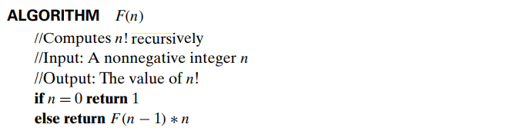


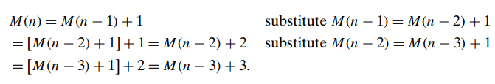
Example 1: Factorial
For simplicity, we consider n itself as an indicator of this algorithm’s input size (rather than the number of bits in its binary expansion)
The basic operation of the algorithm is multiplication, whose number of executions we denote M(n).
we use what can be called the method of backward substitutions
Take advantage of the initial condition given. Since it is specified for n = 0, we have to substitute i = n in the pattern’s formula to get the ultimate result of our backward substitutions

Slide 32
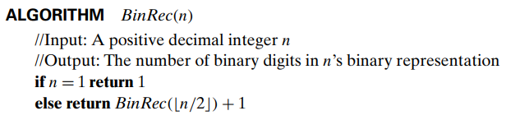



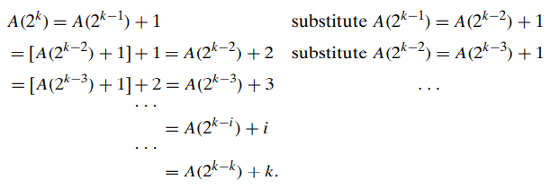



Example 2: Number of binary digits
Let us set up a recurrence and an initial condition for the number of additions A(n) made by the algorithm. The number of additions made in computing BinRec(n/2) is A(n/2), plus one more addition is made by the algorithm to increase the returned value by 1.
The presence of n/2 in the function’s argument makes the method of backward substitutions stumble on values of n that are not powers of 2.
Therefore, the standard approach to solving such a recurrence is to solve it only for $n=2^{k}$ and then take advantage of the theorem called the smoothness rule

Slide 33
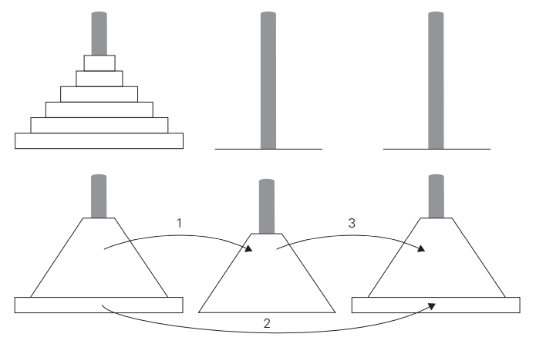
Example 3: Tower of Hanoi
In this puzzle, we have n disks of different sizes that can slide onto any of three pegs.
Initially, all the disks are on the first peg in order of size, the largest on the bottom and the smallest on top.
The goal is to move all the disks to the third peg, using the second one as an auxiliary, if necessary.
We can move only one disk at a time, and it is forbidden to place a larger disk on top of a smaller one.
To move n > 1 disks from peg 1 to peg 3 (with peg 2 as auxiliary), we first move recursively n − 1 disks from peg 1 to peg 2 (with peg 3 as auxiliary), then move the largest disk directly from peg 1 to peg 3, and, finally, move recursively n − 1 disks from peg 2 to peg 3 (using peg 1 as auxiliary). Of course, if n = 1, we simply move the single disk directly from the source peg to the destination peg.

Slide 34

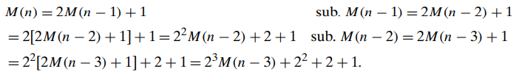

Example 3: Tower of Hanoi
The number of disks n is the obvious choice for the input’s size indicator, and so is moving one disk as the algorithm’s basic operation.
we have an exponential algorithm, which will run for an unimaginably long time even for moderate values of n. This is not due to the fact that this particular algorithm is poor; in fact, it is not difficult to prove that this is the most efficient algorithm possible for this problem. It is the problem’s intrinsic difficulty that makes it so computationally hard.

Slide 35
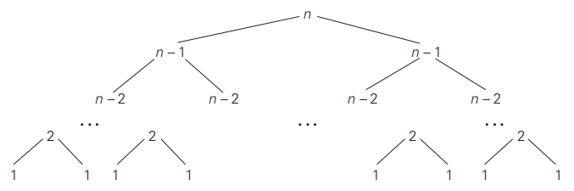

Example 3: Tower of Hanoi
When a recursive algorithm makes more than a single call to itself, it can be useful for analysis purposes to construct a tree of its recursive calls.
In this tree, nodes correspond to recursive calls, and we can label them with the value of the parameter (or, more generally, parameters) of the calls.
By counting the number of nodes in the tree, we can get the total number of calls made by the Tower of Hanoi algorithm

Slide 36
Empirical analysis of time efficiency

Slide 37
Empirical analysis of time efficiency
Select a specific (typical) sample of inputs
Use physical unit of time (e.g., milliseconds)
or
Count actual number of basic operation’s executions
Analyze the empirical data

Slide 38
References
Levitin, A. (2011). Introduction to the design & analysis of algorithms. Boston: Pearson.

